Slide 1
Internal Presenter Notes: What Attendees Should Take Away
Understand modern data warehousing with Azure Synapse Analytics
Loading data using PolyBase
Data Loading best practices

Slide 3
Data loading best practices
Speaker name
Title
Notes:
TALKING POINTS
Introductions: Hi, my name is <speaker name> and in this session, Data Loading best practices we’ll focus on data loading techniques for a cloud-scale enterprise data warehouse in Azure Synapse Analytics.
As a presenter, I encourage you to think about these scenarios apply to your own, or your customers business problems, and how you see the potential of how you can help providing better insights through Cloud Scale Analytics.
I appreciate and welcome questions <pick your own preference here>:
During my presentation
During the presentation, but realize that not all your questions might be addressed, so might defer you to the Q&A section of this presentation
At the end of the presentation

Slide 4
Resources
Session Resources Hub
aka.ms/DATA40
Session Code on GitHub
aka.ms/DATA40Repo
All Event Session Resources
aka.ms/mymsignitethetour
Notes:
TALKING POINTS
In the session, we’ll have demo assets that you would be able to use afterwards for your own learning and exploration.
I encourage you to look at those, capture and review them later.

Slide 5
Agenda
What is Azure Synapse Analytics
Using Polybase to Load Data in a data warehouse
Data Loading best practices
Notes:
TALKING POINTS
In this session well focus on how to optimize data loading at volume in a cloud-scale enterprise data warehouse in Azure Synapse Analytics.
We’ll drill down into the definition of Polybase and learn on how to apply Data Loading best practices

Slide 6
What is Azure Synapse Analytics?
Notes:
TALKING POINTS
Tailwind Traders data loading lends itself to a variety of data ingestion methods, each uniquely identified by the shape or structure of the data. In this session you’ll discover data loading best practices and how to optimize for parallel loads into a cloud data warehouse.
For their cloud data warehouse, Tailwind Traders has implemented Azure Synapse Analytics.
If you haven’t heard about Azure Synapse Analytics, then let’s start demystifying some of the areas around it.

Slide 7

Azure Synapse Analytics
A limitless analytics service with unmatched time to insight, that delivers insights from all your data, across data warehouses and big data analytics systems, with blazing speed
Simply put, Azure Synapse is Azure SQL Data Warehouse evolved
We have taken the same industry leading data warehouse and elevated it to a whole new level of performance and capabilities
Notes:
TALKING POINTS
Azure Synapse is Azure SQL Data Warehouse evolved
Azure Synapse Analytics is a limitless analytics service with unmatched time to insight, that delivers insights from all your data, across data warehouses and big data analytics systems, with blazing speed.
In this session , we will be focusing on the key Azure Synapse Analytics data warehousing features. With the Big Data features, at the time of writing you should call out that the relational Big Data capability is live today. The non-relational Big Data capability will be available in the future. Furthermore, data integration and a unified GUI will also be provided in the future for a complete solution
PRESENTER NOTES AND GUIDANCE
Review:
Same industry leading data warehouse: https://azure.microsoft.com/en-ca/blog/analytics-in-azure-is-up-to-14x-faster-and-costs-94-less-than-other-cloud-providers-why-go-anywhere-else/
PRESENTER NOTES AND GUIDANCE
Review:
Same industry leading data warehouse: https://azure.microsoft.com/en-ca/blog/analytics-in-azure-is-up-to-14x-faster-and-costs-94-less-than-other-cloud-providers-why-go-anywhere-else/

Slide 8




Azure Synapse Analytics
PaaS
Elastic Scale
Big Data
Pause/Resume
Separate
Storage/Compute
Workload
Management
Notes:
TALKING POINTS
Azure Synapse Analytics is a limitless analytics service with unmatched time to insight, that delivers insights from all your data, across data warehouses and big data analytics systems, with blazing speed.
In this session , we will be focusing on the key Azure Synapse Analytics data warehousing features. With the Big Data features, at the time of writing you should call out that the relational Big Data capability is live today. The non-relational Big Data capability will be available in the future. Furthermore, data integration and a unified GUI will also be provided in the future for a complete solution
PRESENTER NOTES AND GUIDANCE
We are not focusing on the preview features of Azure Synapse Analytics

Slide 9

Data Warehouse Architecture
Compute Node
Compute Node
Compute Node
0110101010101010101101010111010101010110
0110101010101010101101010111010101010110
0110101010101010101101010111010101010110
Compute Node
Compute Node
Compute Node
0110101010101010101101010111010101010110
0110101010101010101101010111010101010110
0110101010101010101101010111010101010110
Control Node
Notes:
TALKING POINTS
The data warehouse architecture in Azure Synapse Analytics is build around the core fundamentals of Massively Parallel Processing (MPP)
<Click 1>
A control node takes ownership of query orchestration.
<Click 2>
When a query is submitted to the data warehouse, the query is pushed down for processing to each of the compute nodes.
Note, when you understand how this compute can now execute querying in parallel, we’ll dive into the best practices of loading data.
PRESENTER NOTES AND GUIDANCE
This information is used to serve as a reminder of information you will need to know to present this slide
Refresh yourself with an overview of Azure Synapse Analytics MPP architecture with the following link:
https://docs.microsoft.com/en-us/azure/sql-data-warehouse/massively-parallel-processing-mpp-architecture#sql-analytics-mpp-architecture-components
You don’t need to go into the details, that is covered as part of the best practice presented in this session.

Slide 10
Data Warehouse Processes
Load
Provision
Query
Automate workflow via Azure Data Factory
Notes:
TALKING POINTS
A typical data warehouse consists of provisioning the DW, Loading the data, and making data available for querying.
The provisioning and load process can be accomplished through workflow Automation in Azure Data Factory

Slide 11
Loading design goals
Notes:
TALKING POINTS
Optimizing and speeding up data loads, without impacting the performance of ongoing queries is on of the design goals in data warehousing. Let’s have a look at some details.

Slide 12

Loading design goals
Load data efficiently
Load Data non-obtrusively, respecting concurrent queries and loads Customer voice and product and service maturity govern lead solutions
Reduce table fragmentation as much as possible
Provide system recovery capabilities in the event of data load failure with minimal impact on concurrent queries
Multiple methods of loading
Notes:
TALKING POINTS
Core concepts around loading data efficiently is doing so in a non-obtrusive manner.
During data load, the core goal is to reduce fragmentation, and provide a re-initiate status with system recovery capabilities as well as reduce overall query performance impact.
Loading of data, could be accomplished using multiple load methods.
PRESENTER NOTES AND GUIDANCE
This information is used to serve as a reminder of information you will need to know to present this slide
Refresh yourself with an overview of Azure Synapse Analytics cheat sheet for a holistic overview of the loading design goals with the following link:
https://docs.microsoft.com/en-us/azure/sql-data-warehouse/cheat-sheet

Slide 13




Data warehousing loading in Azure
Loading data into a data warehouse in Azure Synapse Analytics
Data preparation
Read data from files using DBFS
Load processed data into tables optimized for analytics
Azure Databricks
Data ingestion
Data storage
Load flat files
into data lake on a schedule
Applications
Load into SQL DW tables
Visualize
Logs, files, and media
(unstructured)
Azure Data Factory
Azure Storage/ Data Lake Store
Azure Synapse Analytics
Power BI
Dashboards
Serving
Business and custom apps (structured)
Applications manage their transactional data directly
Extract and transform relational data
Azure Data Factory
SQL DB
Transactional storage
Data prep.
Notes:
TALKING POINTS
In previous sessions we discussed data ingestion, data storage and an overall modern data warehouse architecture.
Let’s focus on how we will load data from cloud-based storage, directly into a data warehouse in Azure Synapse Analytics.
PRESENTER GUIDANCE AND NOTES
This information is used to serve as a reminder of information you will need to know to present this slide
Refresh yourself with an overview of Azure Synapse Analytics key components and processes for a holistic overview of the loading design goals with the following link:
https://docs.microsoft.com/en-us/azure/sql-data-warehouse/sql-data-warehouse-overview-what-is#key-component-of-a-big-data-solution
https://docs.microsoft.com/en-us/azure/synapse-analytics/sql-data-warehouse/cheat-sheet
https://docs.microsoft.com/en-us/azure/synapse-analytics/sql-data-warehouse/resource-classes-for-workload-management

Slide 14
Loading Methods
BCP
SSIS
PolyBase
File based
Heterogenous
File based
Notes:
TALKING POINTS
In common data load scenarios, you might have previously used command line tools like BCP, or a graphical tool like SQL Server Integration Services or SSIS.
Polybase is an other technique, which is extremely popular for parallel data loads, and part of the best practices of loading data into an enterprise data warehouse.
We’ll have a detailed look on how to use Polybase, and how Polybase is a common data load scenario in cloud scale analytics.
PRESENTER GUIDANCE AND NOTES
Ask your attendees for a show of hands regarding with they use BCP, SSIS or PolyBase.
This information is used to serve as a reminder of information you will need to know to present this slide
Refresh yourself with the Data loading strategies for Azure SQL Data Warehouse with the following link:
https://docs.microsoft.com/en-us/azure/sql-data-warehouse/design-elt-data-loading
https://sqlofthenorth.blog/2017/06/05/optimizing-ssis-data-loads-with-azure-sql-data-warehouse-polybase/

Slide 15

PolyBase benefits
Best practices for loading large amount of data
Leverages MPP architecture
Azure Data Factory support
Variety of file formats
PolyBase is designed to leverage the MPP (Massively Parallel Processing) architecture of Azure Synapse Analytics and will therefore load and export data magnitudes faster than any other tool.
Azure Data Factory also supports PolyBase loads and can achieve similar performance to running PolyBase manually
PolyBase supports a variety of file formats including RC, ORC and Gzip files.
Notes:
TALKING POINTS
Polybase is designed to leverage the MPP datawarehouse architecture of Azure Synapse Analytics and will therefore load data faster than any other data tool.
Polybase integrates with Azure Data Factory, so you can use Polybase to integrate in an ADF workflow to support a data pipeline.
As Polybase handles the load capabilities of a variety of file formats, it is a versatile instrument to optimize and accelerate data load.
PRESENTER GUIDANCE AND NOTES
Read this article for Azure Data Factory enriches PolyBase support for loading data into SQL DW with the following link:
https://azure.microsoft.com/en-us/updates/azure-data-factory-enriched-polybase-support-for-loading-data-into-sql-dw/
The supported file formats are listed here
https://docs.microsoft.com/en-us/sql/t-sql/statements/create-external-file-format-transact-sql?view=sql-server-ver15

Slide 16



Components of PolyBase
External Data Source
External Tables
External File Format
Notes:
TALKING POINTS
By configuring Polybase, you’ll identify the external data source, file format, to then create what are called “external tables”
You could configure this using T-SQL SYNTAX, as you
In this slide explain the three core components in PolyBase. Outline that they can create these manually using T-SQL, or Azure Data Factory can create these objects through a few clicks of a mouse, and a configuration in Azure Data Factory
PRESENTER NOTES AND GUIDANCE
This information is used to serve as a reminder of information you will need to know to present this slide
Read the following articles to refresh your self of the following objects
External Data Source
https://docs.microsoft.com/en-us/sql/t-sql/statements/create-external-data-source-transact-sql?view=azure-sqldw-latest
External File Format
https://docs.microsoft.com/en-us/sql/t-sql/statements/create-external-file-format-transact-sql?view=azure-sqldw-latest
External Tables
https://docs.microsoft.com/en-us/sql/t-sql/statements/create-external-table-transact-sql?view=azure-sqldw-latest
Also remind students who attended the last sessions the following steps you demonstrated to run PolyBase. The steps can be found at:
Lab 7: Orchestrating Data Movement with Azure Data Factory
Exercise 3: Transforming Data with the Mapping Data Flow
Task 5: Running the Pipeline
Location of demo instructions: https://github.com/MicrosoftLearning/DP-200-Implementing-an-Azure-Data-Solution/blob/master/instructions/dp-200-07_instructions.md

Slide 17
Loading best practices
Notes:
TALKING POINTS
Now that we learned about Polybase for data loading, let’s look into some of the details on how to apply data loading best practices

Slide 18


Manage your files
Compute Node
Compute Node
Compute Node
0110101010101010101101010111010101010110
0110101010101010101101010111010101010110
0110101010101010101101010111010101010110
Compute Node
Compute Node
Compute Node
0110101010101010101101010111010101010110
0110101010101010101101010111010101010110
0110101010101010101101010111010101010110
Control Node
Notes:
TALKING POINTS
<Click>
PolyBase cannot load rows that have more than 1,000,000 bytes of data. Split large compressed files into smaller compressed files for the fastest load, and use compressed delimited text files.
Best practices is to also split larger files so they can allow for parallel processing on the compute nodes.
<Click>
PRESENTER GUIDANCE AND NOTES
This information is used to serve as a reminder of information you will need to know to present this slide
Read this article section on the data loading best practises as it pertains to Azure Synapse Analytics
https://docs.microsoft.com/en-us/azure/sql-data-warehouse/guidance-for-loading-data#preparing-data-in-azure-storage

Slide 19

Reduce concurrent access
Compute Node
Compute Node
Compute Node
0110101010101010101101010111010101010110
0110101010101010101101010111010101010110
0110101010101010101101010111010101010110
Compute Node
Compute Node
Compute Node
0110101010101010101101010111010101010110
0110101010101010101101010111010101010110
0110101010101010101101010111010101010110
Control Node
Notes:
TALKING POINTS
In order to optimize load speeds, it is important to reducing the amount of concurrent access.
This can be accomplished by either running one load job at or running an minimal amount of concurrent load jobs.
PRESENTER GUIDANCE AND NOTES
This information is used to serve as a reminder of information you will need to know to present this slide
Read this article section on the data loading best practises as it pertains to Azure Synapse Analytics
https://docs.microsoft.com/en-us/azure/sql-data-warehouse/guidance-for-loading-data#running-loads-with-enough-compute

Slide 20


Create a dedicated load user account
Compute Node
Compute Node
Compute Node
0110101010101010101101010111010101010110
0110101010101010101101010111010101010110
0110101010101010101101010111010101010110
Compute Node
Compute Node
Compute Node
0110101010101010101101010111010101010110
0110101010101010101101010111010101010110
0110101010101010101101010111010101010110
Control Node
Notes:
TALKING POINTS
In order to optimize for faster load speeds, and assign data loads to designated resource classes, it is recommended to create a dedicated load user account.
Create loading users designated for running loads. Assign each loading user to a specific resource class.
This method is simpler than trying to change a user's resource class to fit the current resource class need.
PRESENTATION GUIDANCE AND NOTES
This information is used to serve as a reminder of information you will need to know to present this slide
Read this article section on the data loading best practises as it pertains to Azure Synapse Analytics
https://docs.microsoft.com/en-us/azure/sql-data-warehouse/guidance-for-loading-data#allowing-multiple-users-to-load

Slide 21

Manage singleton updates
Compute Node
Compute Node
Compute Node
0110101010101010101101010111010101010110
0110101010101010101101010111010101010110
0110101010101010101101010111010101010110
Compute Node
Compute Node
Compute Node
0110101010101010101101010111010101010110
0110101010101010101101010111010101010110
0110101010101010101101010111010101010110
Control Node
Notes:
TALKING POINTS
If you have thousands or more single inserts throughout the day,
batch the inserts so you can bulk load them.
Develop your processes to append the single inserts to a file,
and then create another process that periodically loads the file.
Let’s have a look how a singleton insert moves through the control node, then to the allocated compute node.
Singleton loads, or small transaction loads create unnecessary flow of data.
Goal is to group the append the singleton insert to files and use a faster load option by “batch importing"
PRESENTER GUIDANCE AND NOTES
This information is used to serve as a reminder of information you will need to know to present this slide
Read this article section on the data loading best practises as it pertains to Azure Synapse Analytics
https://docs.microsoft.com/en-us/azure/sql-data-warehouse/guidance-for-loading-data#inserting-data-into-a-production-table

Slide 22

Optimize your loads
Staging data, a 2 step process
Azure Synapse Analytics
Load into SQL DW tables
Azure Storage/ Data Lake Store
Staging Tables
Production Tables
Notes:
TALKING POINTS
A common scenario in loading data is by using a two-step, load process that involves the creation of staging tables.
Usually, to achieve the fastest loading speed for moving data into a data warehouse table,
load data into a staging table.
Best practices would be to define the staging table as a heap (non-indexed table) and use a round-robin mechanism for the distribution option.
Define the staging table as a heap and use round-robin for the distribution option.
However, if the the production table uses a hash distribution, the total time to load and insert
might be faster if you define the staging table with the hash distribution.
Loading to the staging table takes longer, but the second step of inserting the
rows to the production table does not incur data movement across the distributions.
PRESENTER GUIDANCE AND NOTES
This information is used to serve as a reminder of information you will need to know to present this slide
Read this article section on the data loading best practises as it pertains to Azure Synapse Analytics
https://docs.microsoft.com/en-us/azure/sql-data-warehouse/guidance-for-loading-data#loading-to-a-staging-table
Also be aware of the distribution you would use
https://docs.microsoft.com/en-us/azure/sql-data-warehouse/massively-parallel-processing-mpp-architecture#distributions

Slide 23


Create statistics after loading
Improve the query performance for users
Azure Synapse Anlytics
Production Tables
Notes:
TALKING POINTS
To improve query performance, it's important to create statistics on all
columns of all tables after the first load, or substantial changes occur
in the data. This can be done manually or you can enable auto-create statistics.
PRESENTER GUIDANCE AND NOTES
This information is used to serve as a reminder of information you will need to know to present this slide
Read this article section on the data loading best practises as it pertains to Azure Synapse Analytics
https://docs.microsoft.com/en-us/azure/sql-data-warehouse/guidance-for-loading-data#creating-statistics-after-the-load

Slide 24
Demo: Loading data into Azure Synapse Analytics Data Warehouse
Notes:
DEMO GUIDANCE
Let’s have a look on our data load process using Polybase
REVIEW THE DETAILED DEMO GUIDE FOR STEPS AND PREREQUISITES

Slide 25
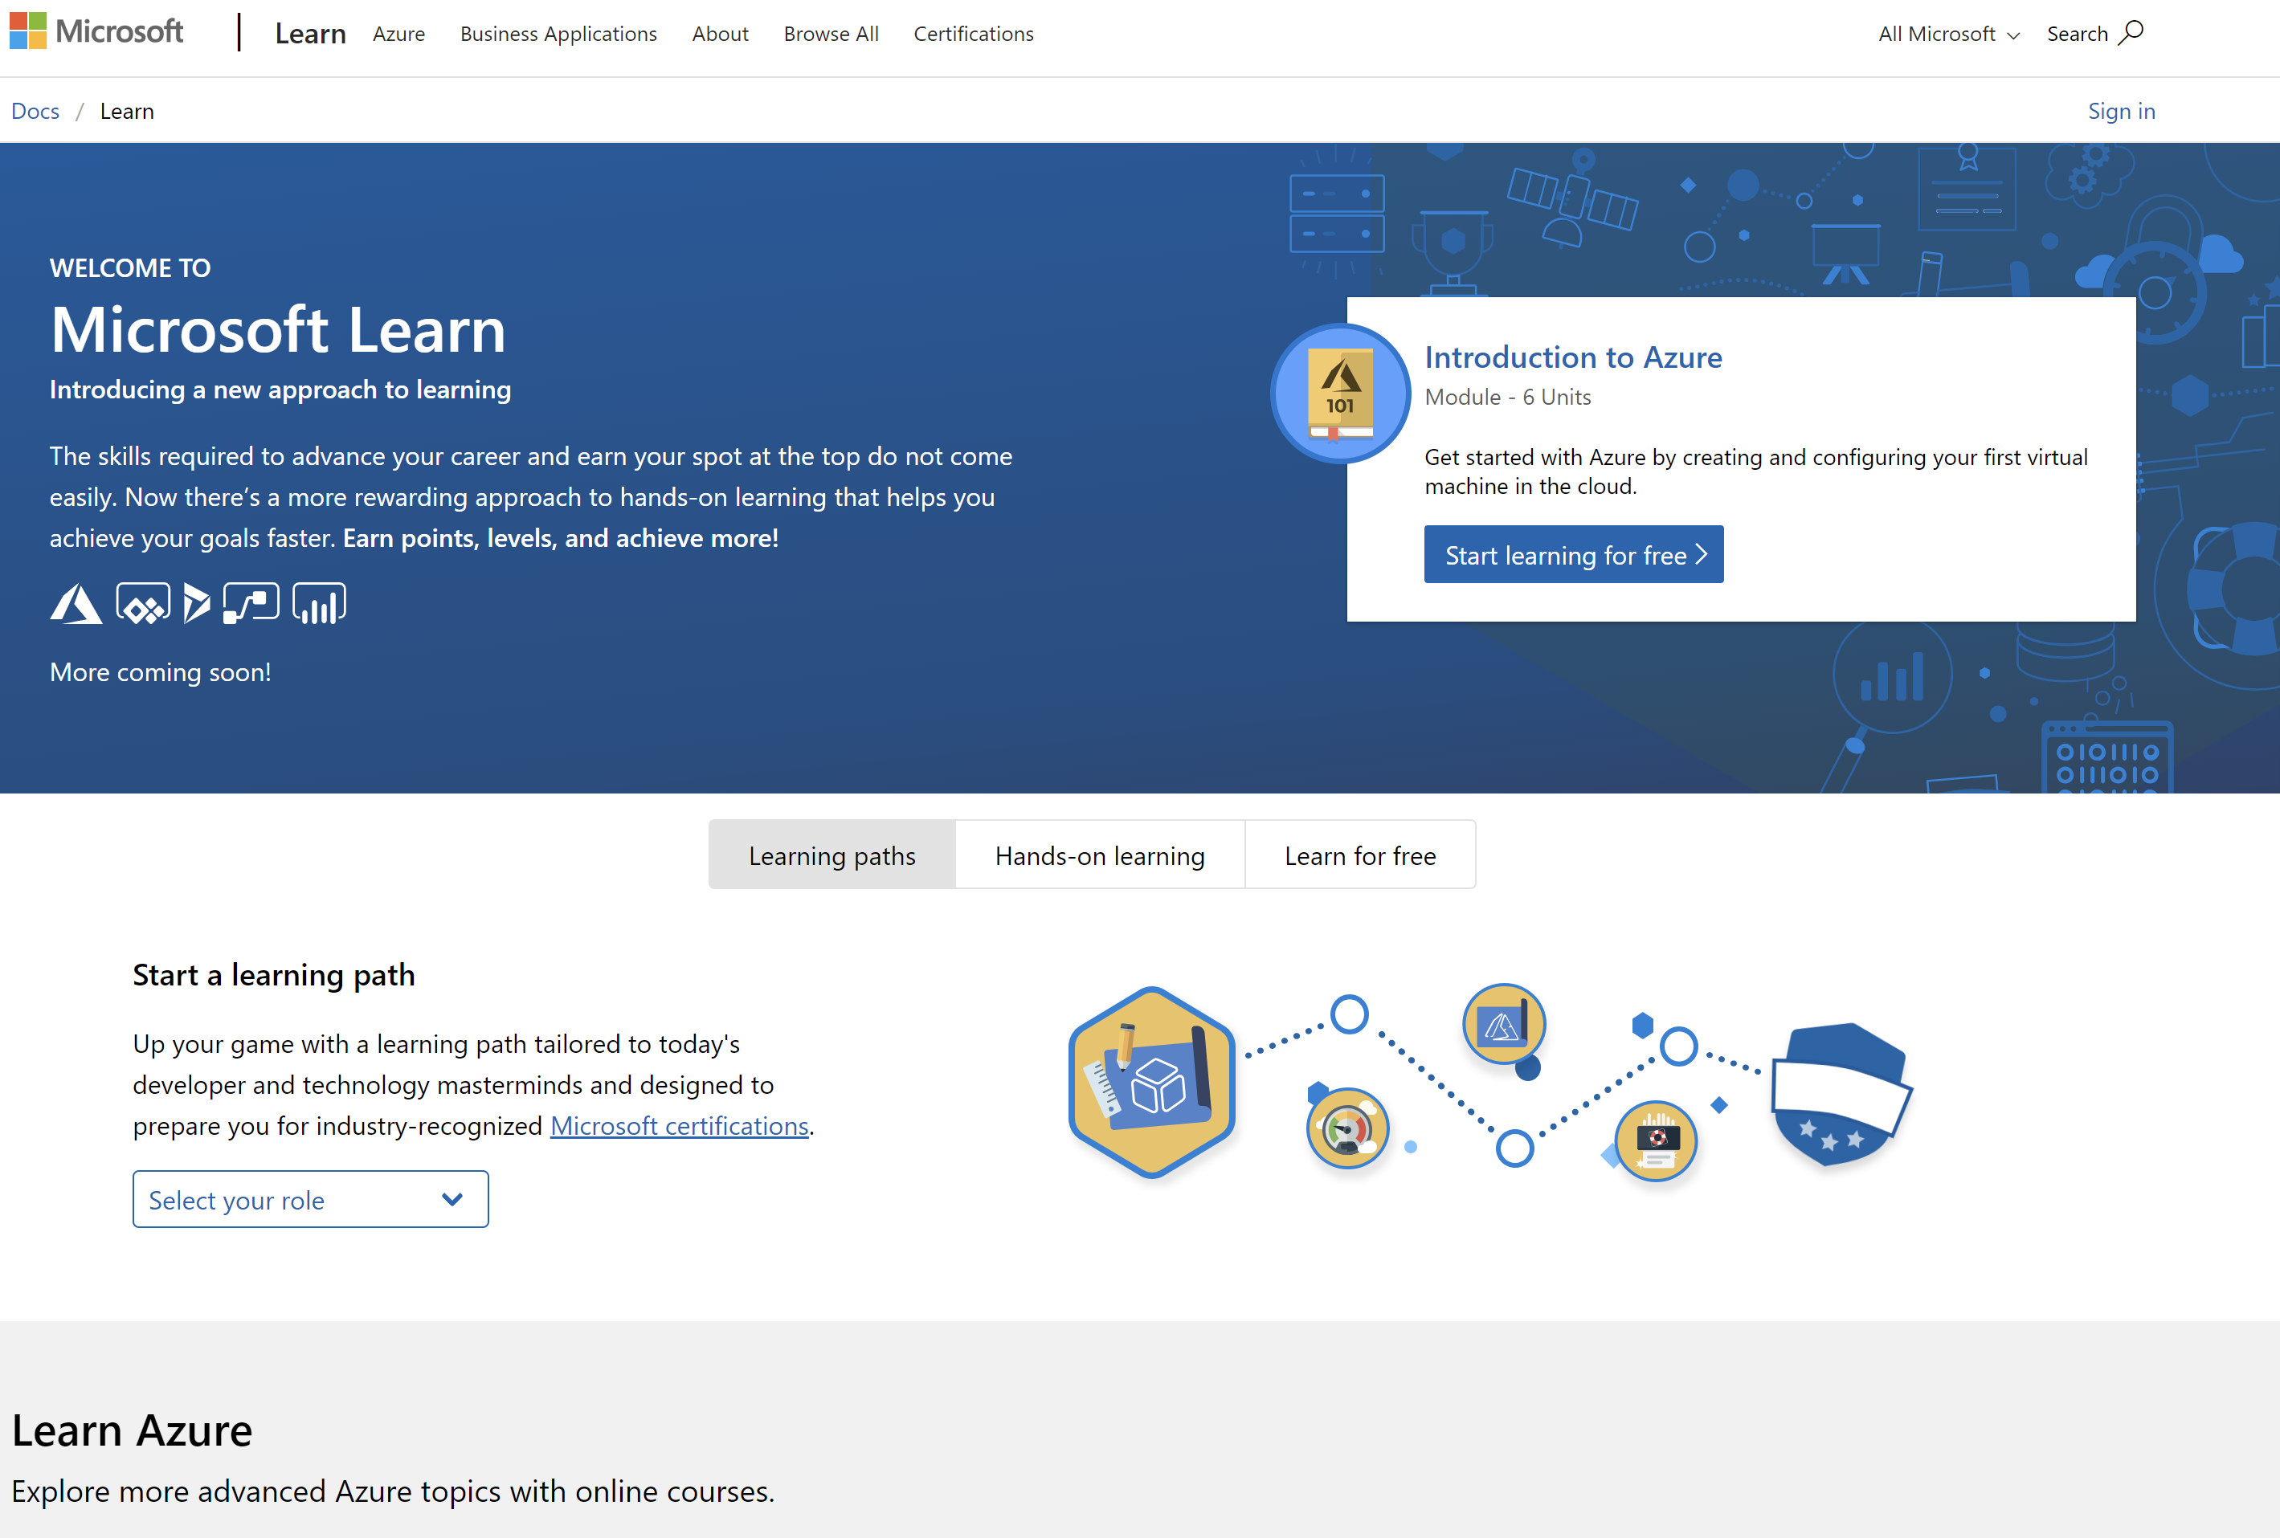
/MS Learn alert
Complete interactive learning exercises, watch videos, and practice and apply your new skills.
aka.ms/DATA40MSLearnCollection
Notes:
https://aka.ms/DATA40MSLearnCollection

Slide 26


Get Certified
Resources
Session Resources
aka.ms/DATA40
Session Code on GitHub
aka.ms/DATA40repo
All Event Resources
aka.ms/mymsignitethetour
aka.ms/azuredataengineer
#MSIgniteTheTour
Notes:
TALKING POINTS
As mentioned at the beginning of the session, we bundled all resources to this session
This Learning Path provides a step towards pursuing the Microsoft Certified: Azure Data Engineer Associate level certification.
The link to this certification, and the skills being measured on the certification exams associated with this role-based certifications are available for you here.

Slide 27
Data loading best practices
Speaker name
Title
Notes:
\

